Slide 1
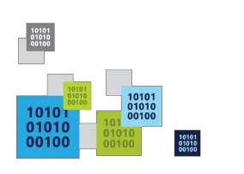
How to Build & Deploy to HoloLens

Slide 2
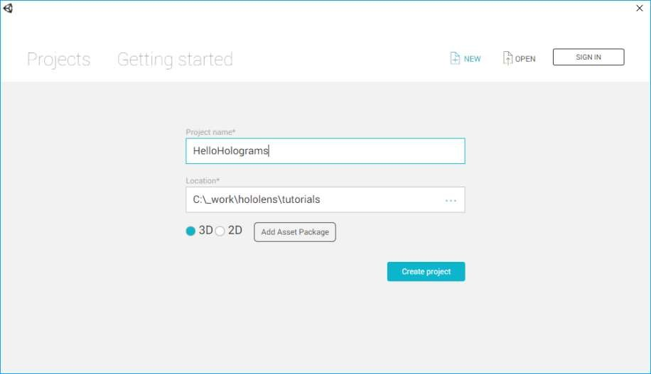
1. Create a New Project
Any name
Empty location 3D
https://developer.microsoft.com/en-us/windows/holographic/holograms_100

Slide 3
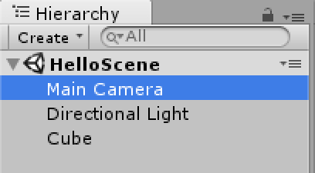
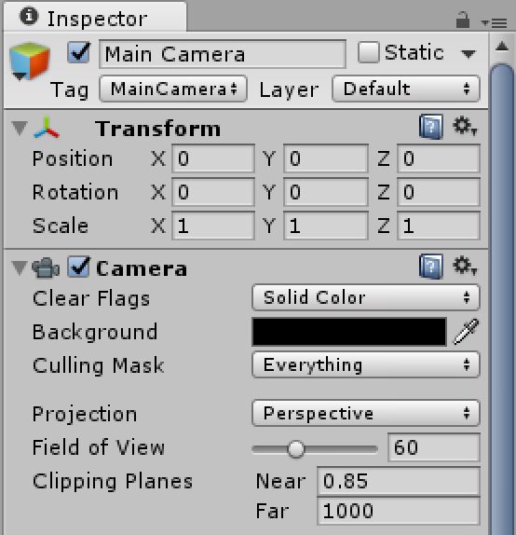
2. Set Up the Camera
X, Y, Z
= (0,0,0)
Solid
Color
R,G,B,A
= (0,0,0,0)
In the Hierarchy panel,
select Main Camera
Near = 0.85

Slide 4
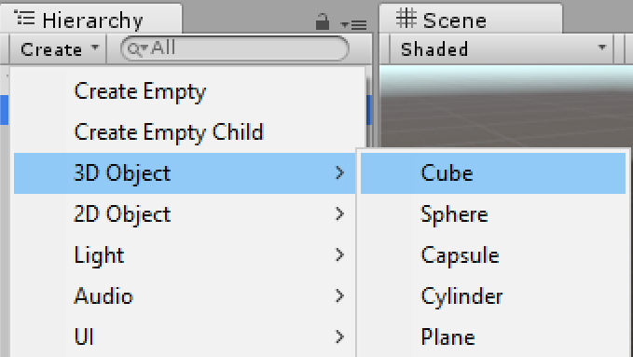
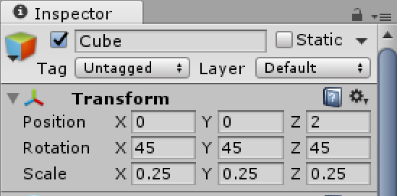
3. Create a Hologram
Position = (0, 0, 2)
Rotation = (45, 45, 45)
Scale = (0.25, 0.25, 0.25)
In Hierarchy Panel,
Create | 3D Object | Cube

Slide 5
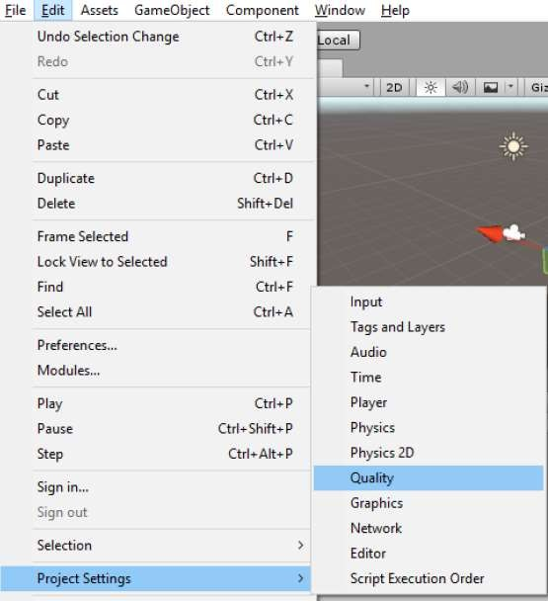
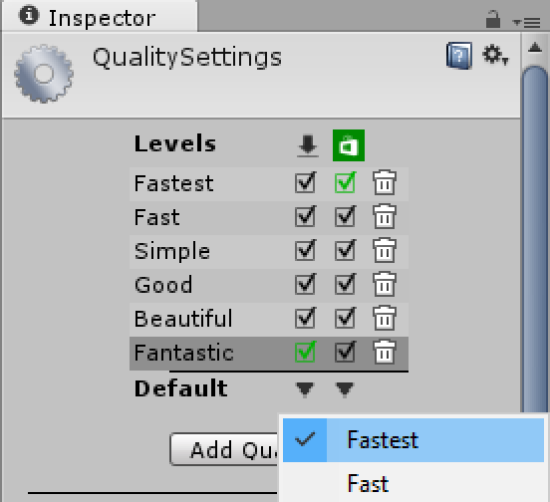
4. Export from Unity to Visual Studio: Quality
Click File | Project Settings | Quality
For Windows, select Fastest

Slide 6
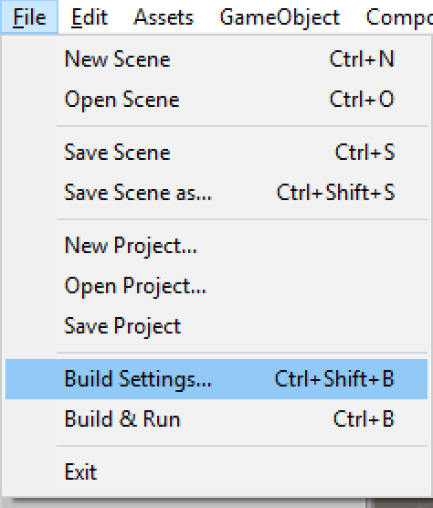
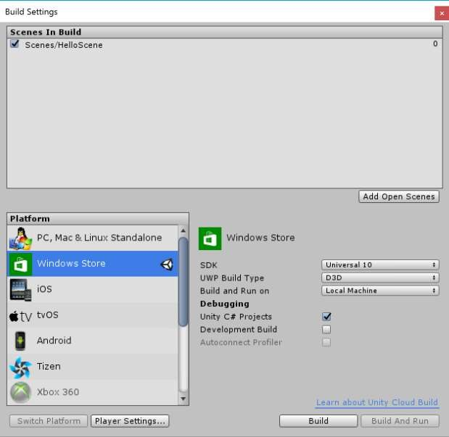
4. Export from Unity to Visual Studio: Build Settings

Slide 7
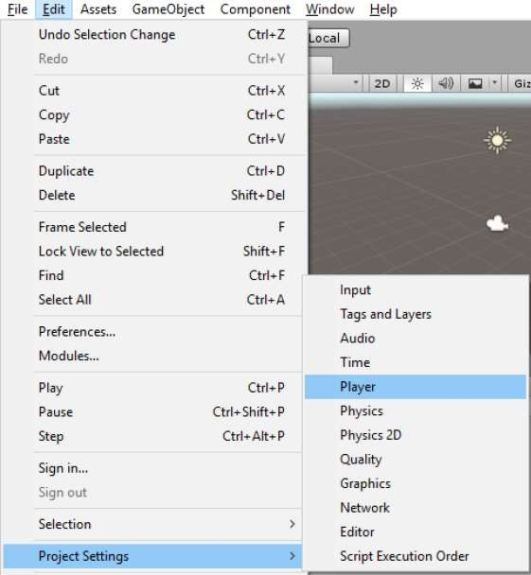
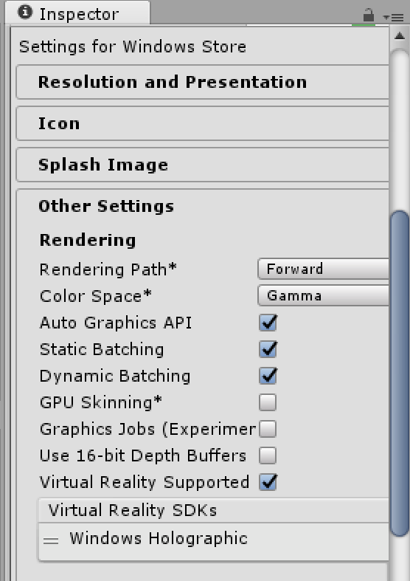
4. Export from Unity to Visual Studio: Player Settings
Click File | Project Settings | Player
Check for VR support

Slide 8
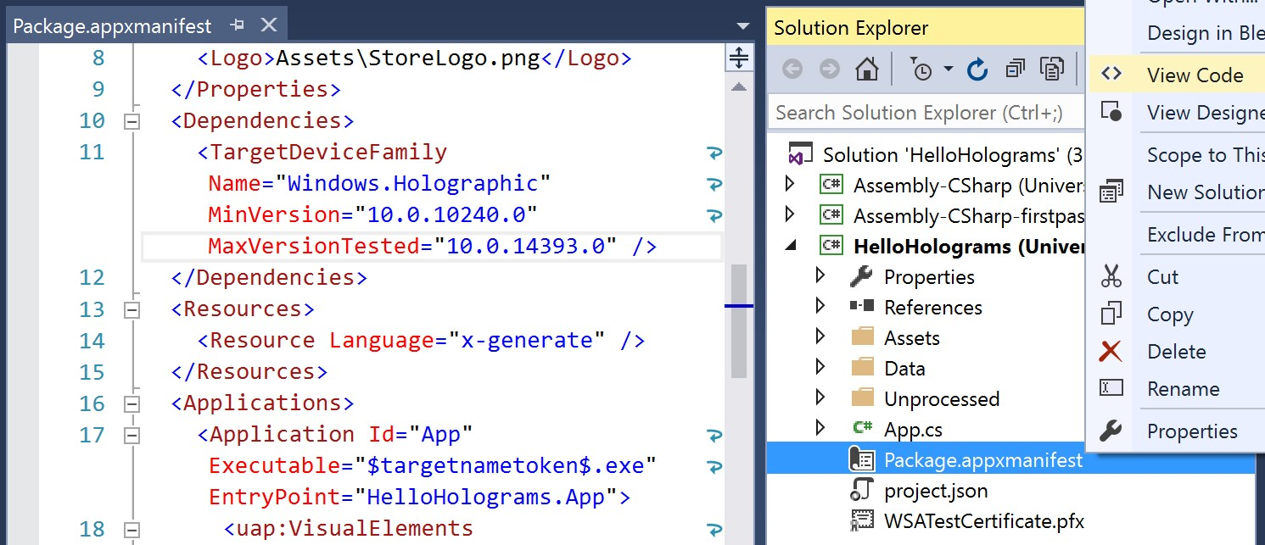
4. Export from Unity to Visual Studio: Manifest
Right-click manifest file to View Code

Slide 9
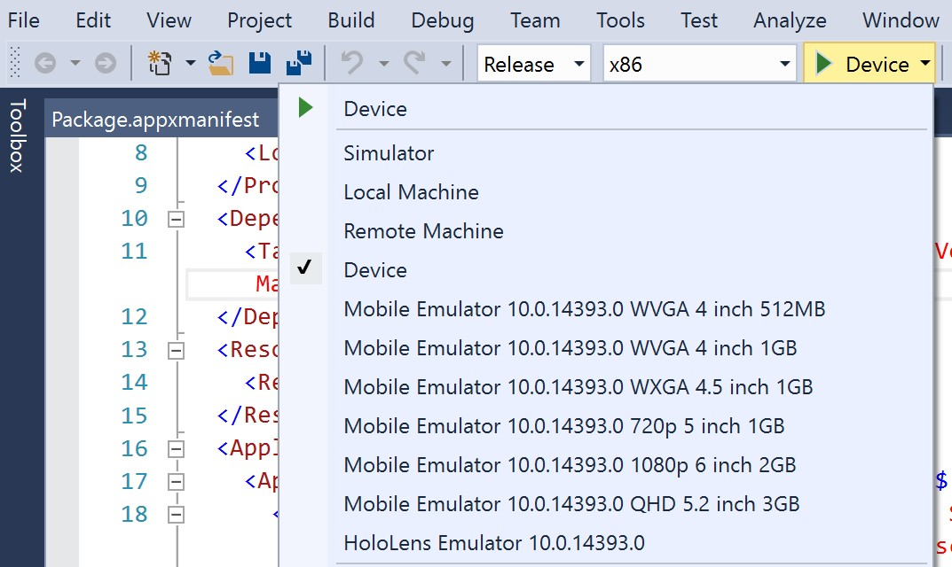
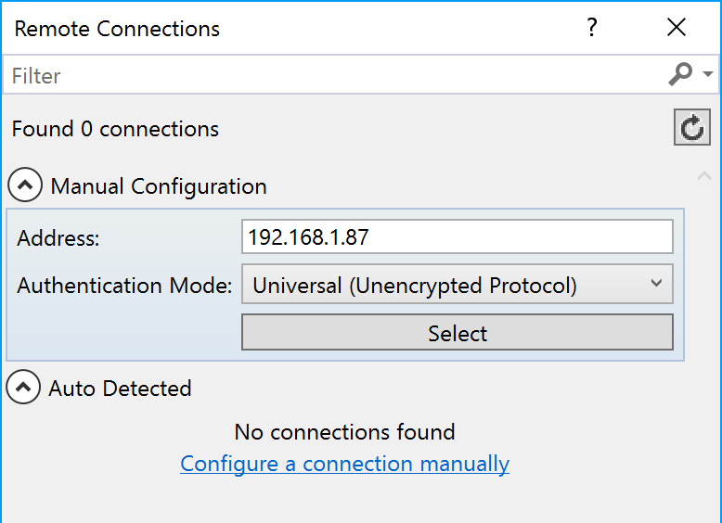
5. Build and Deploy: Remote, Device, Emulator
Select x86 (not ARM or x64)
For remote connections:
Enter device IP address
Select Auth Mode: Universal

Slide 10
6. Build and Deploy: Remote, Device, Emulator
Select x86 (not ARM or x64)
For remote connections:
Enter device IP address
Select Auth Mode: Universal

